Slide 1
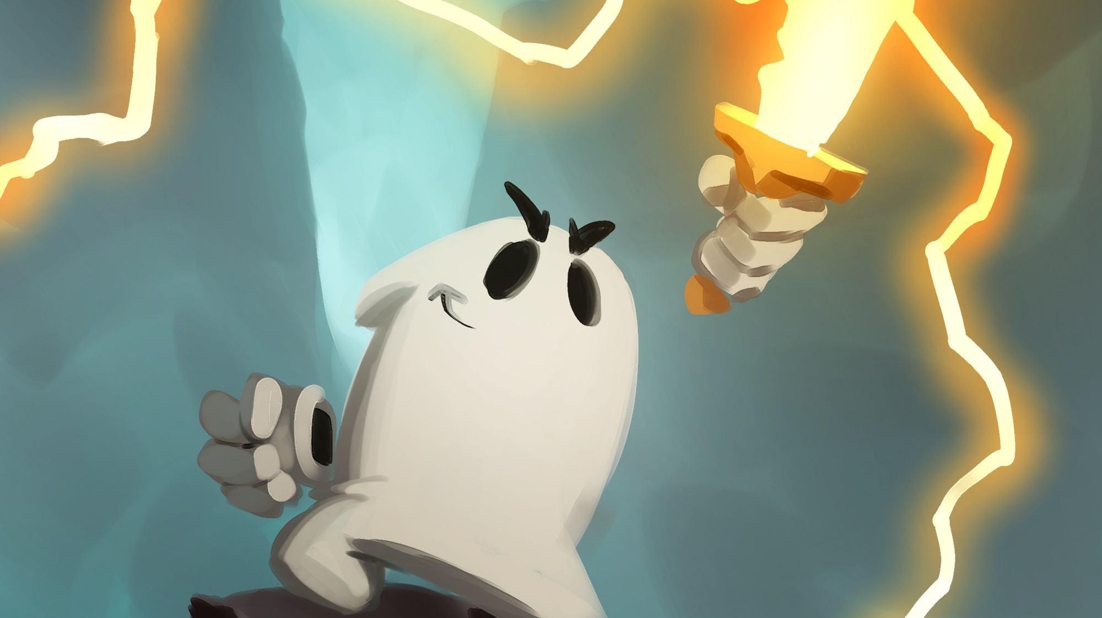

THE PILLOW WITH POWER
ALCHEMY INTERACTIVE
Live publisher pitch · NAGIS · Game Con Canada
Notes:
OPEN (~20s): They've seen it and played the demo. Don't explain the pillow. Pivot immediately to: who's behind it, and why we ship.

Slide 2
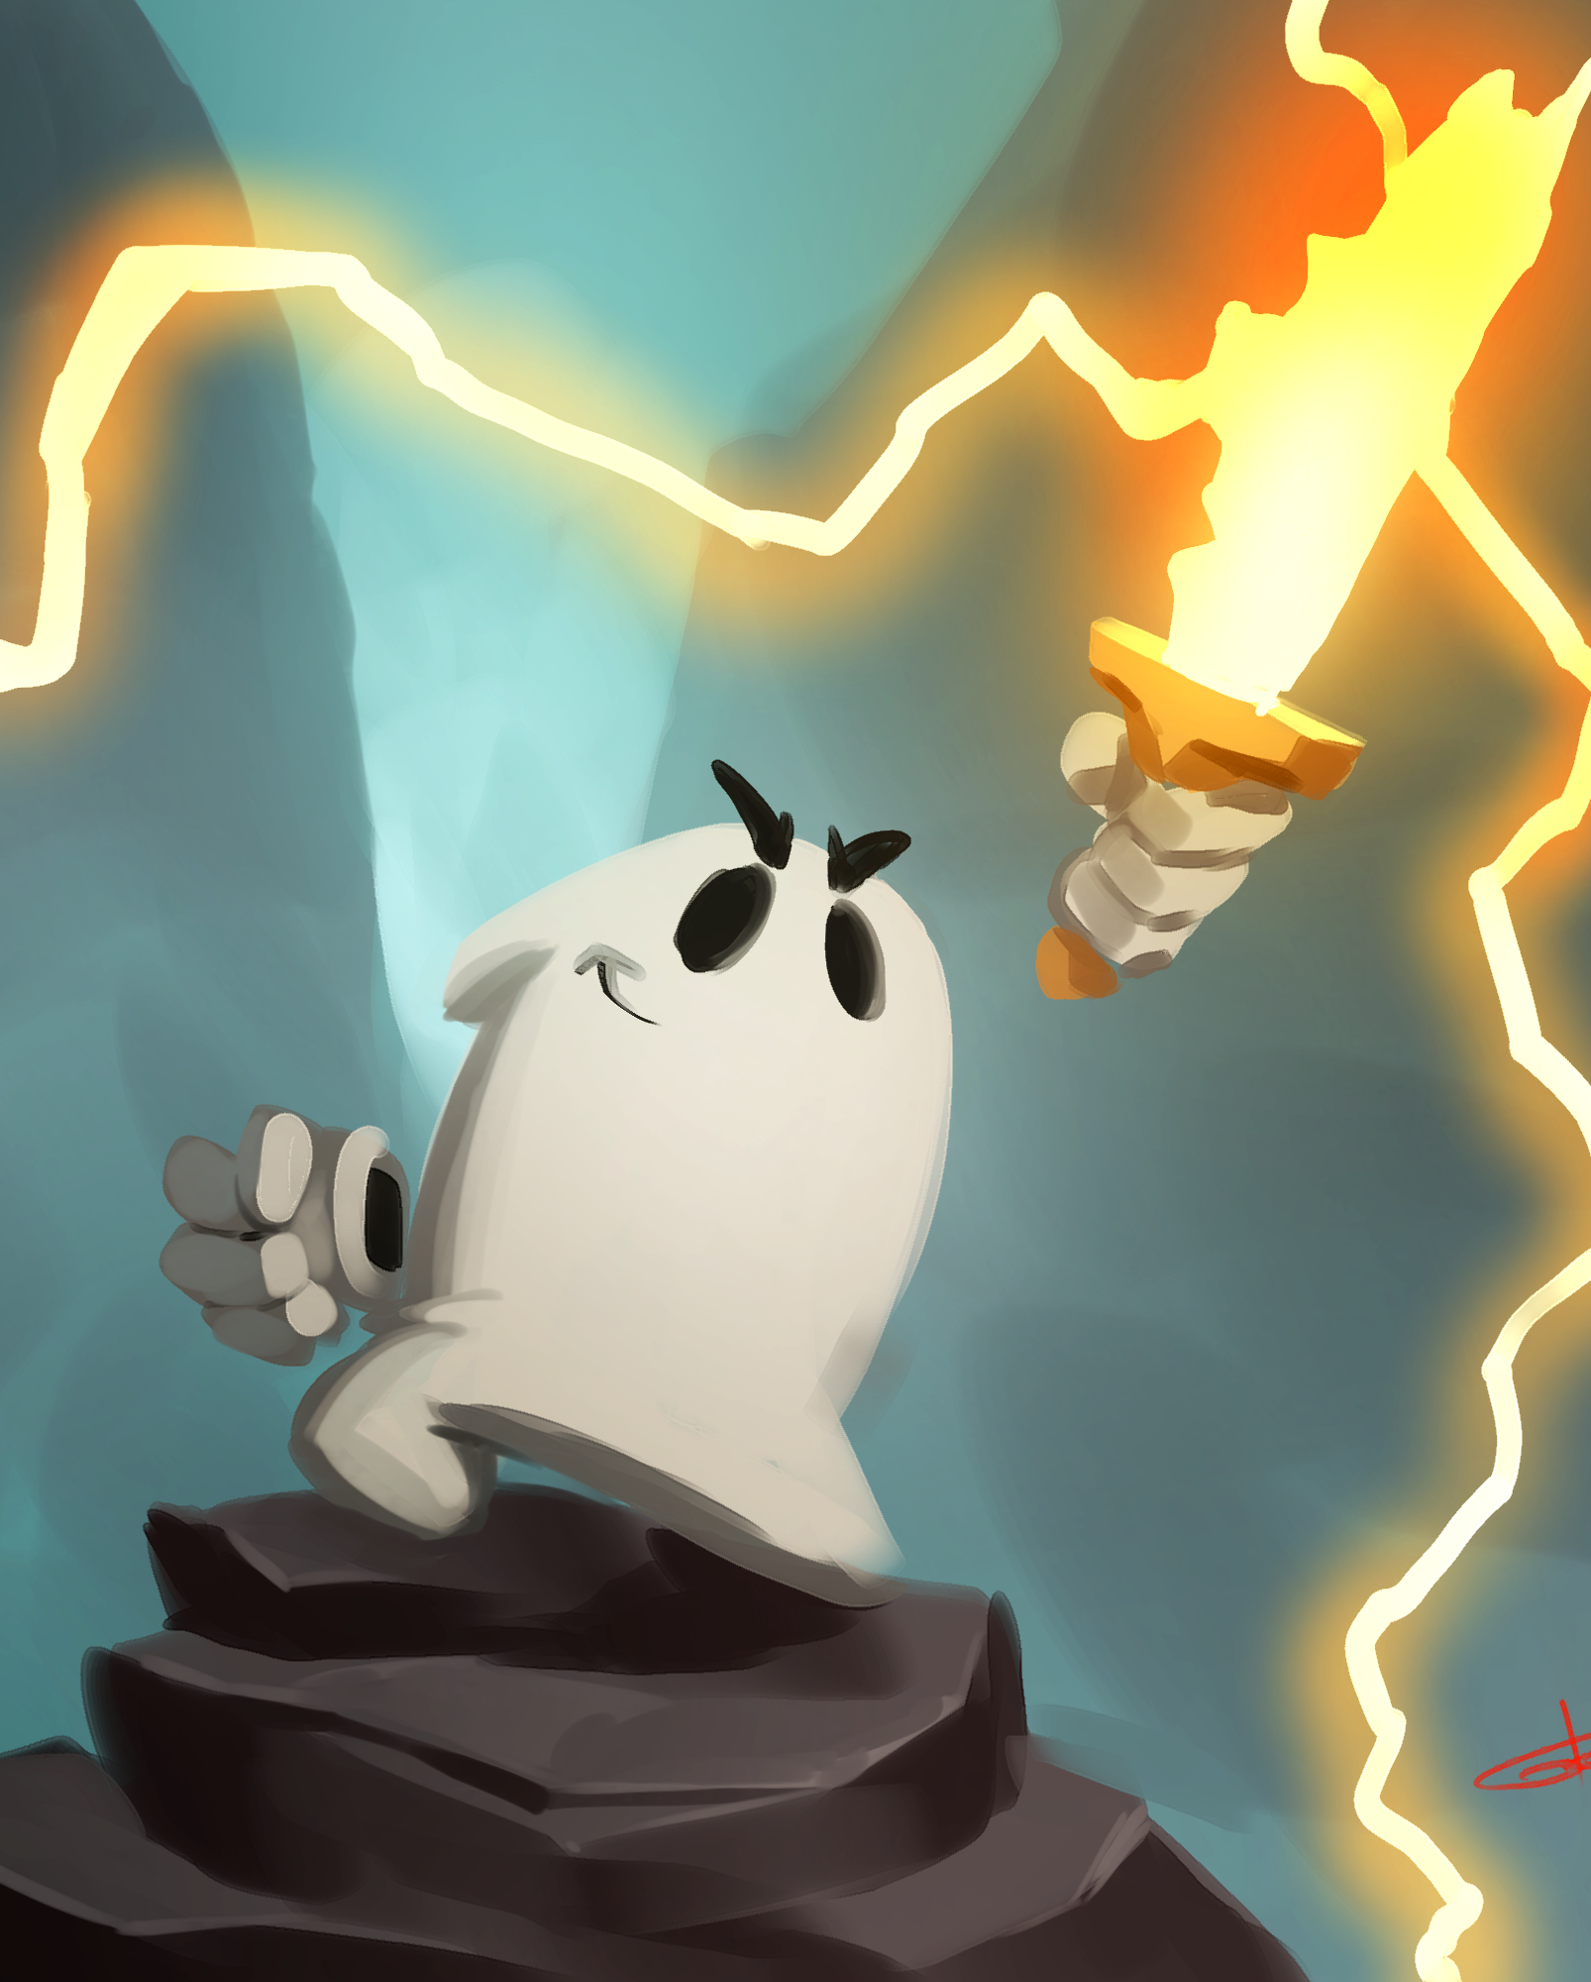
WHY BACK THIS TEAM
We don't just make games.
We run companies.
15 years
I've run Alchemy Imageworks — a web & design studio — for 15 years, through COVID and a downturn, in a brutal market.
A second company
My wife took our IT division and built it into a thriving business. She's our CFO.
$170K already in
$90K of my own money + ~$80K private investment. We've de-risked this ourselves.
Notes:
WHY US (~70s): We're artists who also run real businesses — we make payroll, hit deadlines. $285K + a roadmap is exactly what we do for a living. And we've already put our own money in.

Slide 3
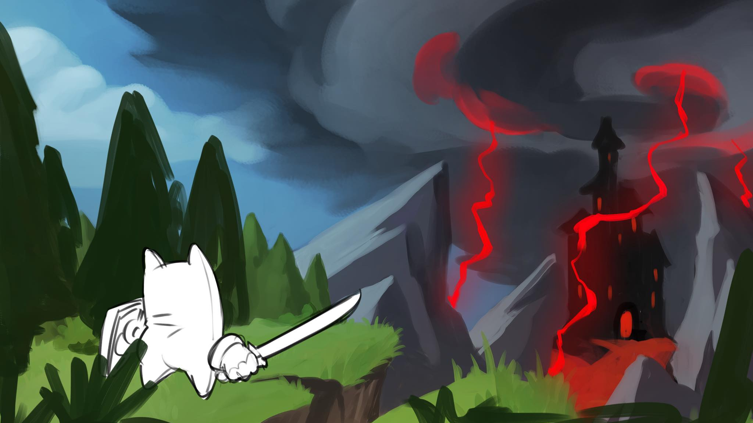
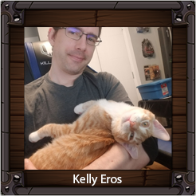
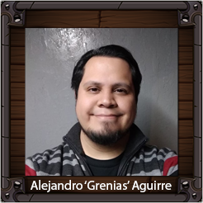
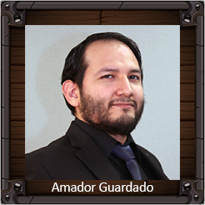
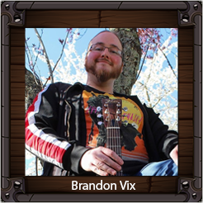
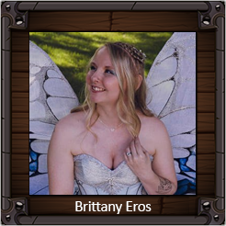
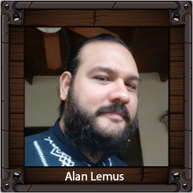
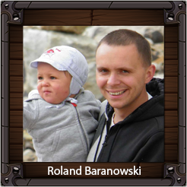
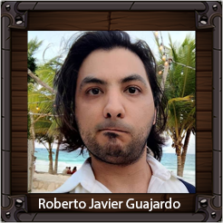
THE PEOPLE BEHIND IT
Six years together. Still here.
Kelly Eros
Alejandro ‘Grenias’ Aguirre
Amador Guardado
Brandon Vix
CEO · Game Design
Art Direction
Lead Developer
Music & SFX
Brittany Eros
Alan Lemus
Roland Baranowski
Roberto J. Guajardo
CFO · Accounting
Senior Animator
Senior Unity Dev
Senior Unity Dev
Notes:
THE TEAM: 8 people, six years, mostly volunteered hours because they believe in it. Retention isn't a risk — funding finally lets us pay loyalty we've already earned.

Slide 4
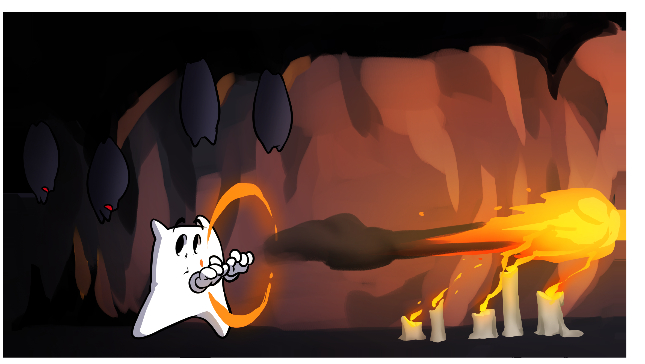
THE GAME
You've already played it.
So this is all we'll say about it:
A living pillow as your hero
found nowhere else in the genre
Hand-drawn, frame by frame
Saturday-morning-cartoon soul
Six elemental magics
combat + puzzles + metroidvania
15 worlds · ~18 hours
with replay, DLC & challenge modes
Notes:
BRIDGE: Let the art on screen carry a beat. They can see the quality — you're just naming the four things that make it unmistakably SAK'D.

Slide 5
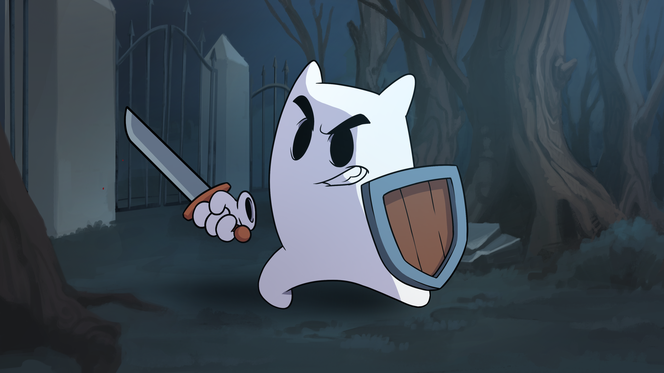
THE ASK
$285,000
CAD
to finish development.
Plus the three things a great publisher does better than we can alone:
Marketing reach
QA support
Console porting — Switch & Switch 2 first
Notes:
THE ASK (~45s): $285K to finish + marketing, QA, porting. Switch/Switch 2 is the #1 target beyond PC. Be clear; this is the number.

Slide 6
WHERE IT GOES · AND WHAT IT RETURNS
17 months to launch — Q4 2027
Core Dev
Alpha
Beta
Gold
Launch
Months 1–5
Months 6–9
Months 10–12
Months 13–14
Months 15–17
THE NUMBERS — Steam only, conservative VG Insights comparables
$24.95
18K
44K
130K+
launch price · CAD
units · first month
units · first 3 months
units · year one (≈220K with free DLC)
Switch and every other platform is upside on top of this.
Notes:
Conservative, Steam-only. Modular roadmap = scope can flex (DLC/extra quest are add-ons). Switch is upside, not baked in.

Slide 7

BEYOND THE GAME
It's a universe, not a title.
A full transmedia rollout is mapped: webisodes, animation, comics, sequels and adjacent titles — built around one of the most marketable original characters on the market.
Rare reach
Full localization including a Cree language option — almost unheard of in games, reaching a large, underserved Canadian audience.
Built-in accessibility
Adjustable difficulty, a parental feather-vs-blood toggle, and customizable characters widen the audience from day one.
Notes:
UPSIDE (~35s): You're not funding one title — you're getting in early on a character and a universe. Cree + accessibility = reach and press most indies never get.

Slide 8

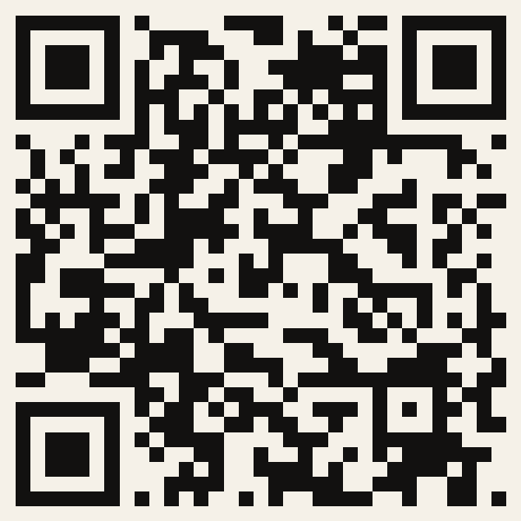
Let's build it together.
The game can be made — it's already being made. The question is whether it reaches its full potential, on every console, in front of the widest possible audience.
Kelly Eros
kelly@alchemyinteractive.ca
780-983-6051
Full deck & pitch
Play the demo
sakd.ca
on Steam
Scan for the detailed pitch & playable demo
Notes:
CLOSE (~15s): Hand them the decision. End every meeting with: 'What would you need from us to take this further?' Point to sakd.ca for depth.

